Slide 1

Identity and Access Management
Chirag Gaur-18BEC0021
B.Tech Electronics and Communication Engineering
Capstone Project

Slide 2
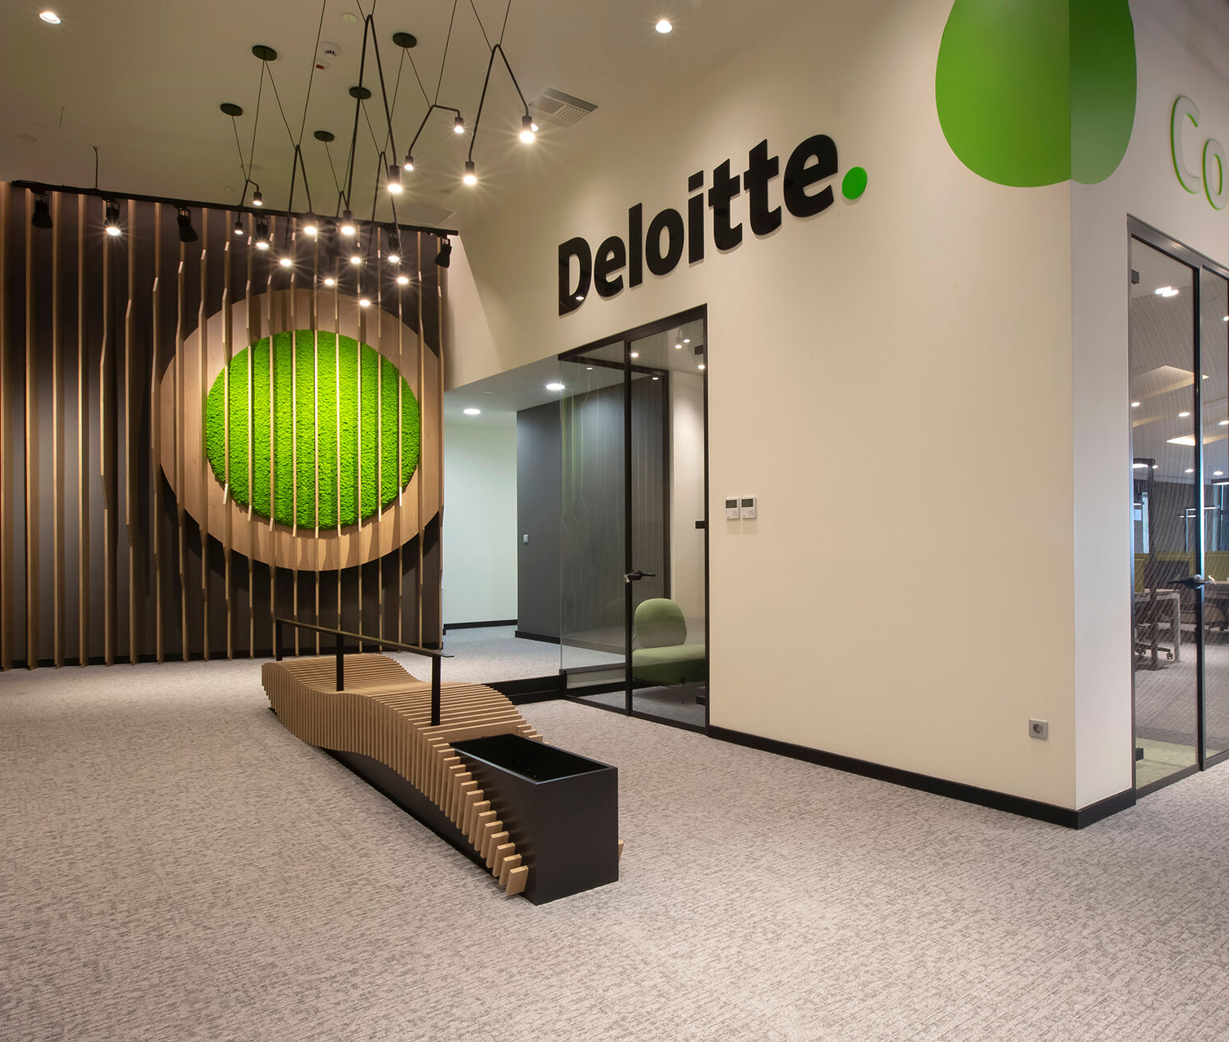
About the company
Deloitte is a multinational expert offerings community with workplaces in over a hundred and fifty international locations and territories across the globe.
Deloitte is headquartered in London, England, and is one of the Big Four accounting firms. Deloitte gives audit, consulting, monetary advisory, threat advisory, tax, and prison offerings with about 334,800 experts globally.
Deloitte gives offerings to more than 90% of customers proposing in Fortune 500.
Deloitte has been a home for tens and hundreds of professionals who dream to create a future for themselves in this speedy developing world

Slide 3
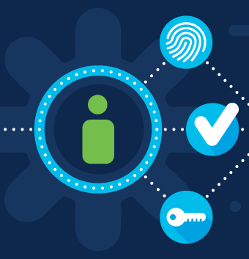
Objectives
My internship’s major goal was to understand Identity and Web Access Management.
PingIdentity products were used as the tools to demonstrate the concepts of Authentication, Authorization, Single Sign-On (SSO).
Some of the use-cases were also implemented with the PingIdentity products.

Slide 4
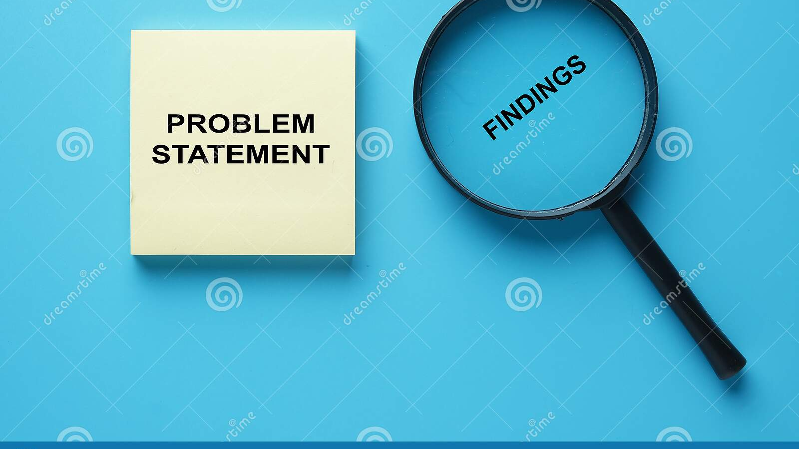
Problem Statements
Generally, there are numerous employees in an organization and at different positions and domains. This creates a lot of manual work of giving different access level to resources to the employees having different working roles.
The product required us to get a better understanding of the concepts of Authentication, Authorization, Single Sign-On (SSO). For this we were required to use PingIdentity products as tools to demonstrate the Authentication, Authorization, SSO.

Slide 5

Solution
Identity and Access Management monitors the lifespan of user identities and entitlements across all corporate resources, including data centers and the cloud. It authenticates users and limits access to systems, networks, and data, making it a fundamental control of cloud security.
IAM keeps a check on the security of all sensitive information of an organization. It allows businesses to restrict access to existing enterprise platforms while also facilitating cloud migration. IAM ensures that policies follow the user regardless of device or locations to protect and have secure access to data anywhere, anytime, and from any device.
When access is judged high-risk, access management features provide adaptive authentication, which reduces risk by increasing login restrictions for users based on device, location, and behavior.

Slide 6

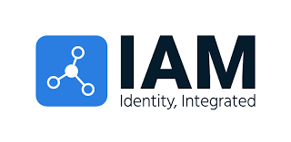


BOOTCAMP- I
IAM

Slide 7
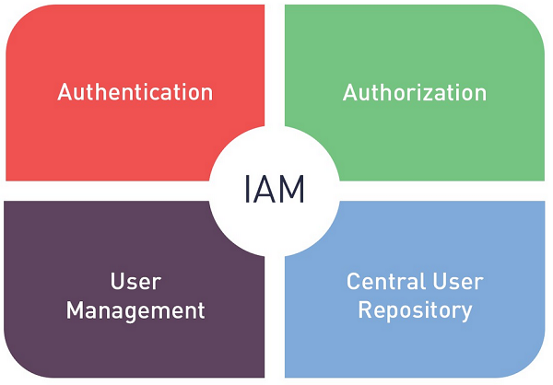
Introduction to IAM
IAM stands for Identity and Access Management. IAM ensures that the right people and job roles in an organization can access the tools they needed to do their jobs.
IAM acts as an interface between identity of the users and the resources that users want to access.
IAM specifies that correct permissions be given to the correct employees for the various applications of the organization.

Slide 8
Terminologies in IAM
Digital Identity/Identity: The digital representation of a user, including a unique identifier, credentials, core attributes, and context-specific attributes.
Authentication (AuthN): The process of establishing a user’s identity by providing a login ID and password in order to access one or more information systems.
Authorization (AuthZ): The process of determining whether a user is permitted to access an application or data.
Provisioning: IAM service responsible for creation of user accounts in information technology (IT) resources and providing appropriate access to those accounts.
Self service: Enabling end user to perform specific activities (e.g., password reset, access request) without the requirements to call service desk.
Authoritative Source: An authorised origination point or “source of truth” for a piece of data (e.g. HR for employee) about a user identity.
Connector/Adapter: Technology used by IAM System to interface and interact with managed systems.
IT Resource/System: Application, system, platform for which access is required to perform a specific function. IAM integrates with these IT resources for user account management.

Slide 9
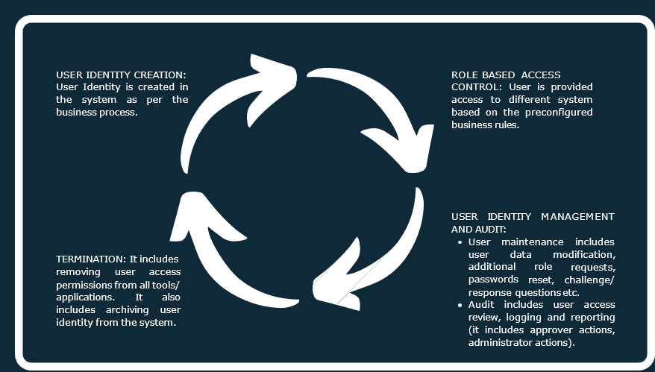
Identity Life Cycle Management

Slide 10
Problems solved using IAM
IT Admin
Too many user stores, password change and account access requests
Manual account creation and synchronization
Multiple user repositories exist that are not reconciled, increasing administrative complexity and the potential for outdated or orphaned accounts. Identity theft is constantly attempted in unprotected zones of your network.
Developer
Redundant code in each application for authentication and authorization
Rework code too often as the application, product,
End User
Users with multiple accounts compromise security through inadequate credential management.
Too many passwords to manage
Long waits for access to business applications and resources
Auditors and Regulators
Limited auditing/reporting ability
Inadequate detection points in business processes create security gaps that are not detected by standard auditing monitors.
Personally identifiable information, such as a person's address and social security number, is not monitored or audited for access compliance with existing laws or organizational policy.
Business Owner
Too expensive to reach new partners, channels
Need for control/approval for access to application
Affiliated organizations are not integrated into a security monitoring program.

Slide 11

BOOTCAMP- II
SailPoint

Slide 12
Introduction to SailPoint
Sailpoint is an automated version of identity management that lowers the expense and complexity of identity management for users while still granting them access.
SailPoint Identity IQ is made up of four main components:
Compliance Manager.
Lifecycle Manager.
Governance Platform.
User Provisioning.

Slide 13
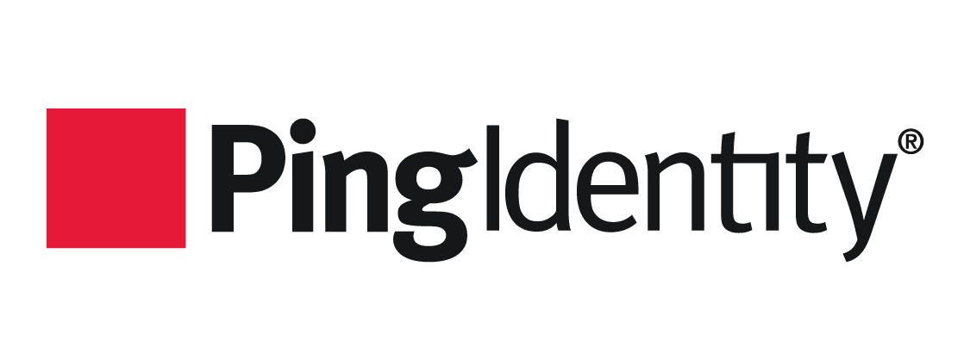
BOOTCAMP- III
PingIdentity

Slide 14
Introduction to PingIdentity
PingIdentity is a Commercial off the Shelf (COTS) web access management product provides secure and seamless access to applications on cloud, mobile, SaaS and on-premise applications. It provides Identity Access Management and single Sign-On (SSO) solution to enterprises and organizations across the industries.
Following products of PingIdentity were used during the Internship tenure:
PingDirectory: It is a fast, scalable directory used to store identity and profile data of the clients.
PingFederate: It is a central authentication solution allowing customers, and partners to securely access all of their web applications from any device.
PingAccess: It is a centralized access security solution that provides secure access to web applications

Slide 15
Open Standard Protocols
 | SAML 2.0 | OAuth 2.0 | OIDC 2.0
Acronym | Security Assertion Mark-up Language | Open Authorization | OpenID Connect
What is it? | Open standard for authentication & authorization | Open standard for authorization | Open standard for authentication
History | Developed by OASIS in 2001 | Developed by Twitter and Google in 2006 | Developed by OpenID foundation in 2014
Application | SSO For enterprise | API Authorization | SSO for consumer application
Format | XML | JSON | JSON
Protocols | HTTP, SOAP | HTTP | HTTP
The protocols used in PingIdentity are:
SAML 2.0
OAuth 2.0
OpenID Connect

